Slide 1
Kaixuan Yao 25 Nov 2019
Chin lab
Phys. Rev. Lett. 123, 170503

Slide 2
Neutral Atom Quantum Computing
Qubits: Atom array
1D, 2D, 3D…
Computational basis: hyper-fine spin states
Excellent coherence time
Single qubit gate: Microwave/ Raman
Entanglement: Rydberg blockade

Slide 3
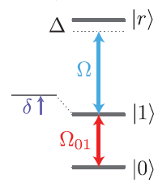
Experiment Setup
420 nm
B = 8.5G
⁸⁷Rb
Global coupling beams with local detunings
Blockade 2π × 24 MHz
Ω ≈ 2π × 3.5 MHz. 420nm & 1013nm, through 6P_{3/2}
Ω01 ≈ 2π × 250 kHz

Slide 4
Single Qubit Manipulation
Raman laser:
Sidebands of laser under DSBSC amplitude modulation with EOM
Carrier detuned by 100 GHz
Account for induced lightshift
(~20 kHz)

Slide 5
State preparation
F=2
F=1
Interlacing Raman pulses and optical pumping
Repeat 70 times in 300 us, fidelity 99.3(1)%

Slide 6
Traditional CZ gate
Rydberg pulse:
Control
π
π
Target
2π
Control | 0 | 0 | 1 | 1
Target | 0 | 1 | 0 | 1
|r>
|1>
|0>
Target phase shift 0 π 0 < π

Slide 7
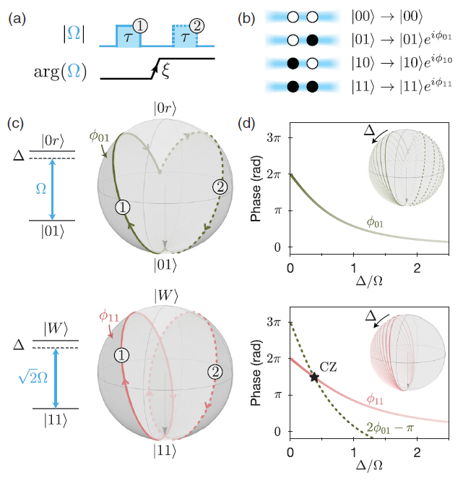
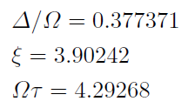
New CZ gate
Stronger coupling to |r> if both atoms are in |1>
Two pulses with a phase shift
Experimentally tune τ and ξ
Faster (0.4 us)
Require only global couplings

Slide 8
Set of gates
Global X
Local Z
Two qubit CZ

Slide 9
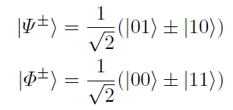
Preparing Bell state
Blow away |1>

Slide 10
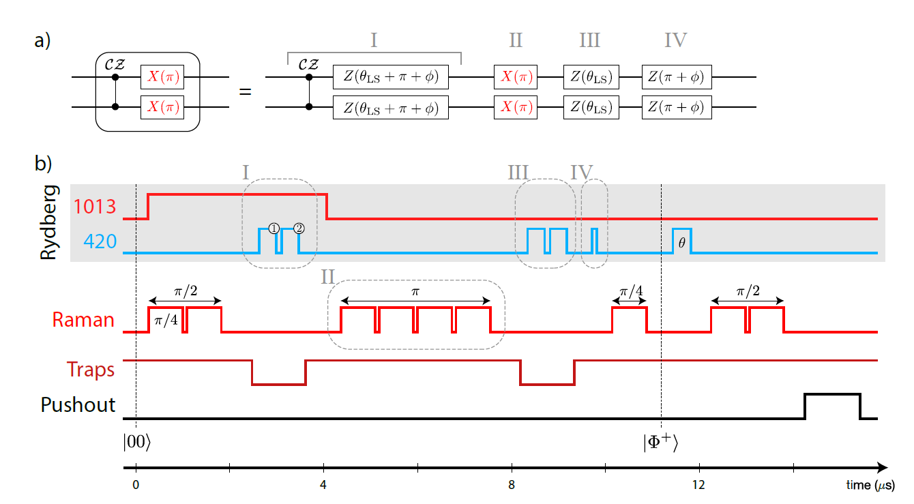
Preparing Bell state

Slide 11
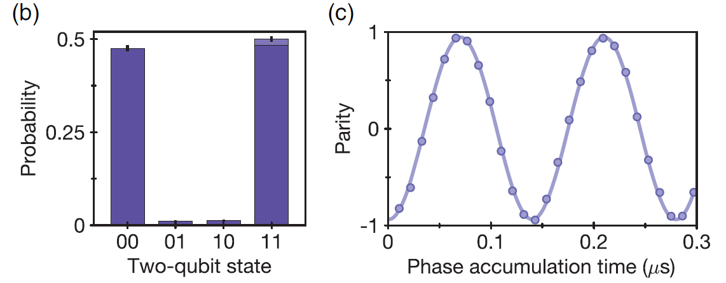
Bell state fidelity

Slide 12
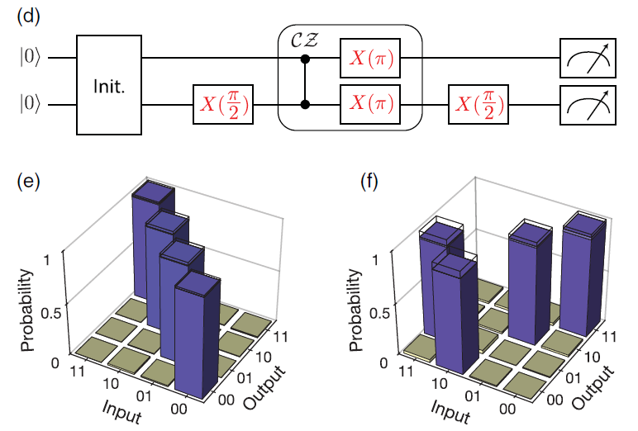
CNOT gate

Slide 13
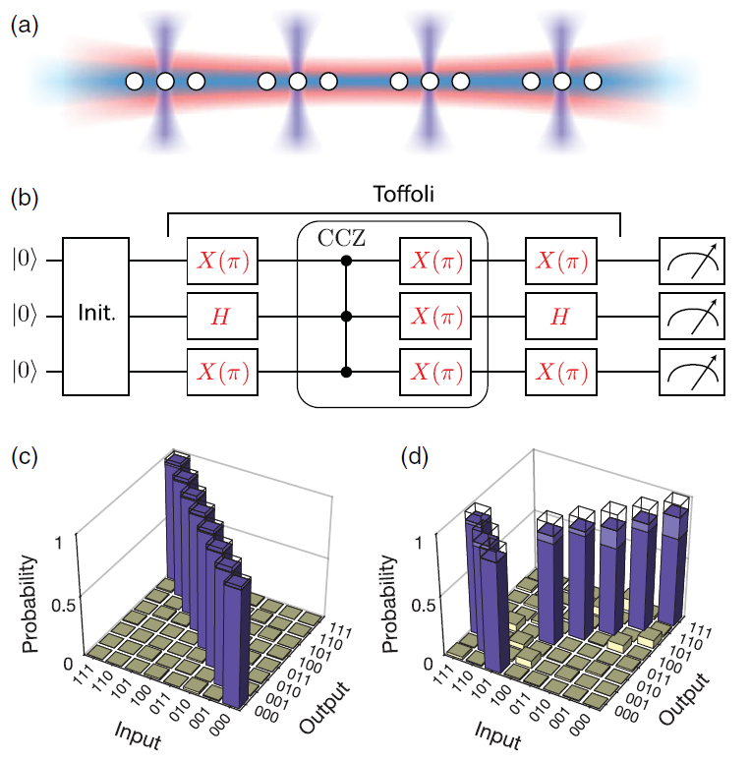
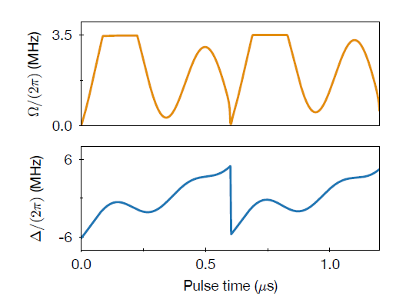
Toffoli gate
Can build from 5 single/two qubit gates
Try using triplets of blockaded atoms:
Numerically find global pulse shape

Slide 14
Summary
Realized Rydberg-mediated entanglement of hyperfine qubits
New CZ gate protocol requiring only global Rydberg coupling, thus insensitive to crosstalk
Competitive fidelity of CZ gate
(99.5% for superconducting qubits, 97.5% for ions)
npj Quantum Information volume 5, Article number: 84 (2019)
arXiv:1903.08181

Slide 15
Outlook
Contiguous array:
Use local addressing beams to shift Rydberg resonance
Nondestructive state readout:
Stern-Gerlach
State dependent fluorescence

