Slide 1
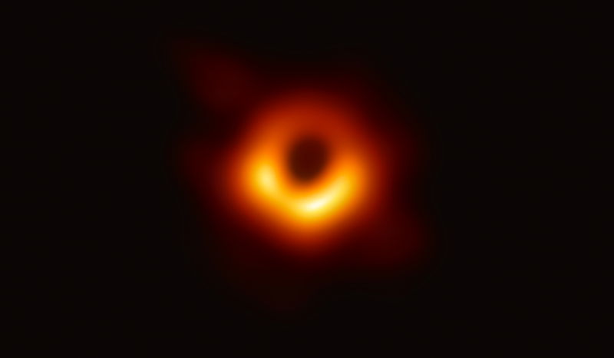
The Event Horizon Telescope
Journal Club - April 22, 2019

Slide 2
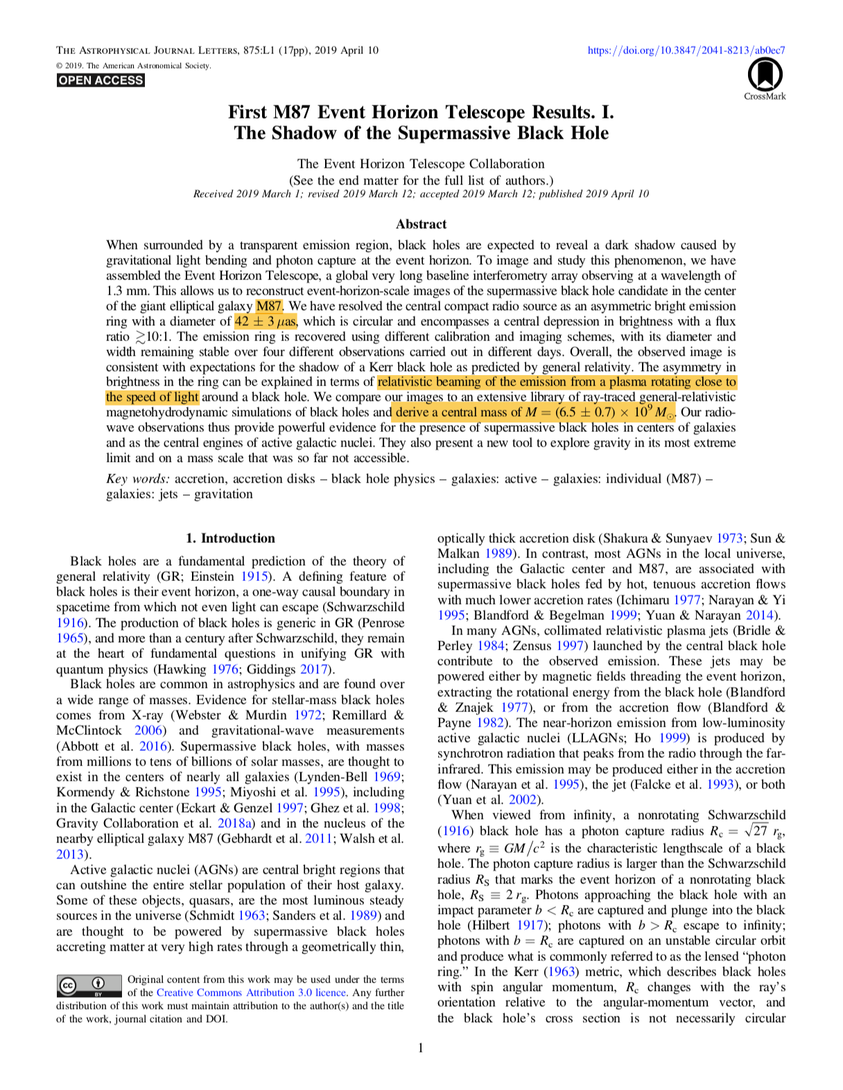
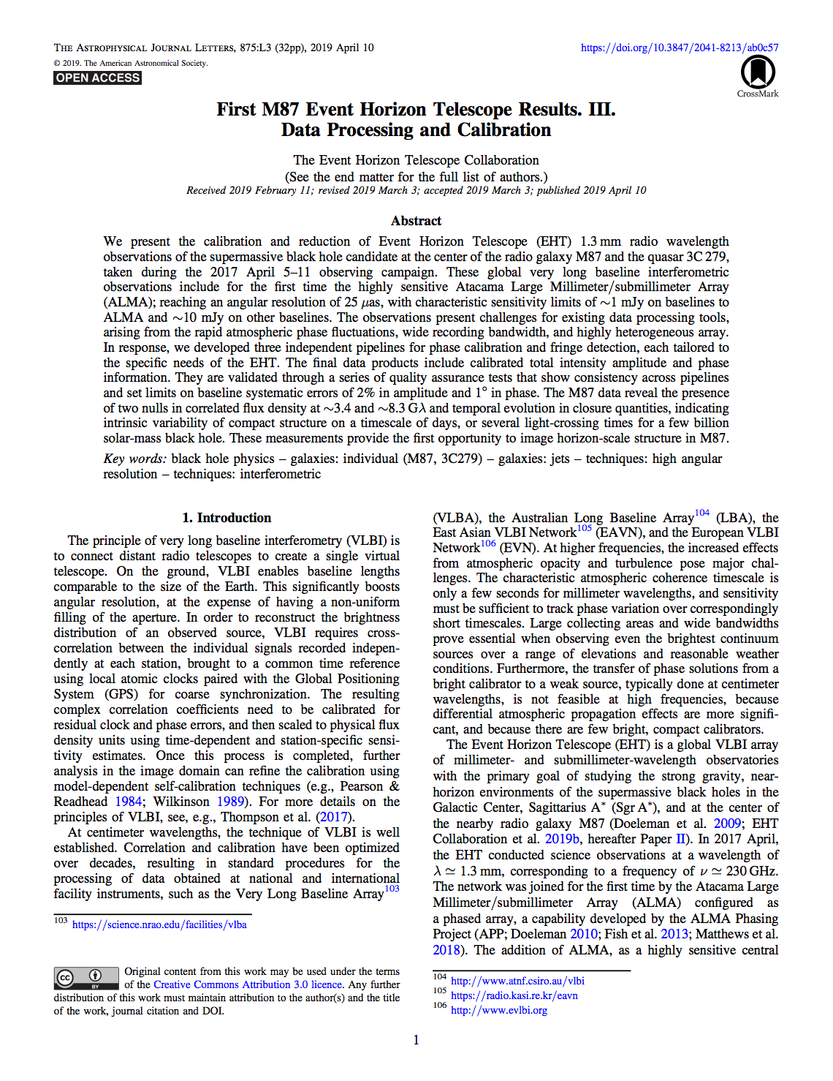
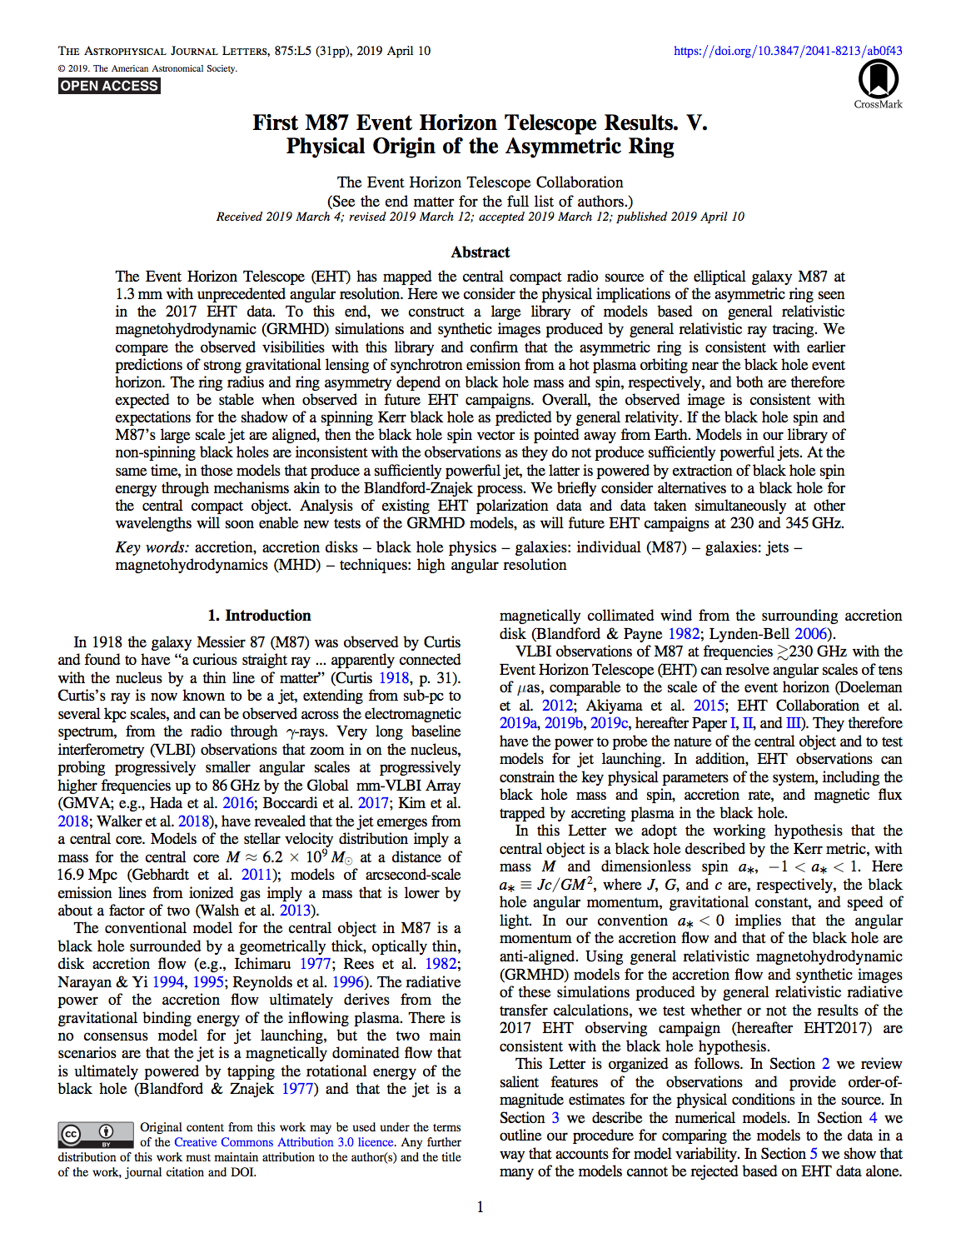
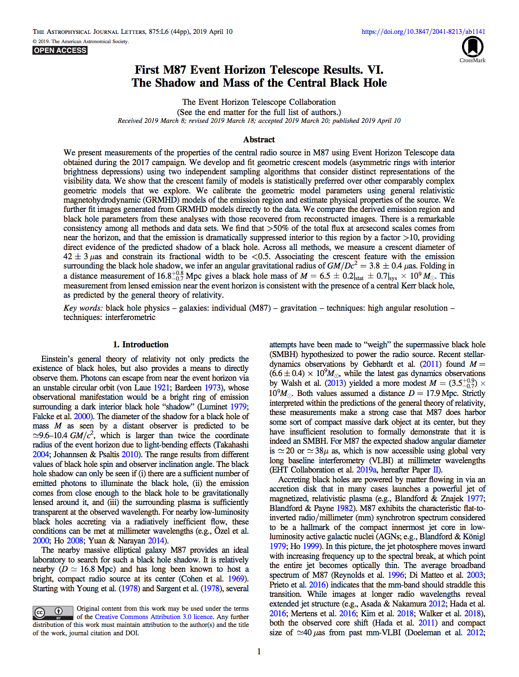
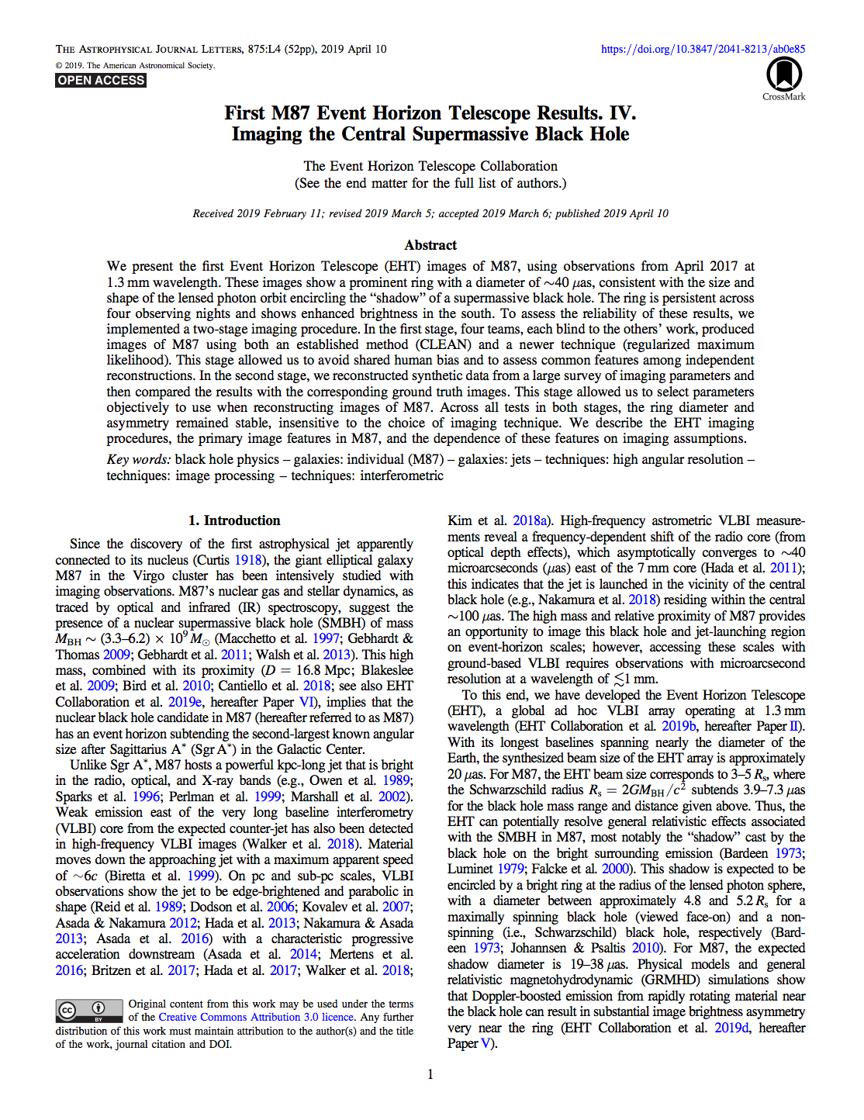
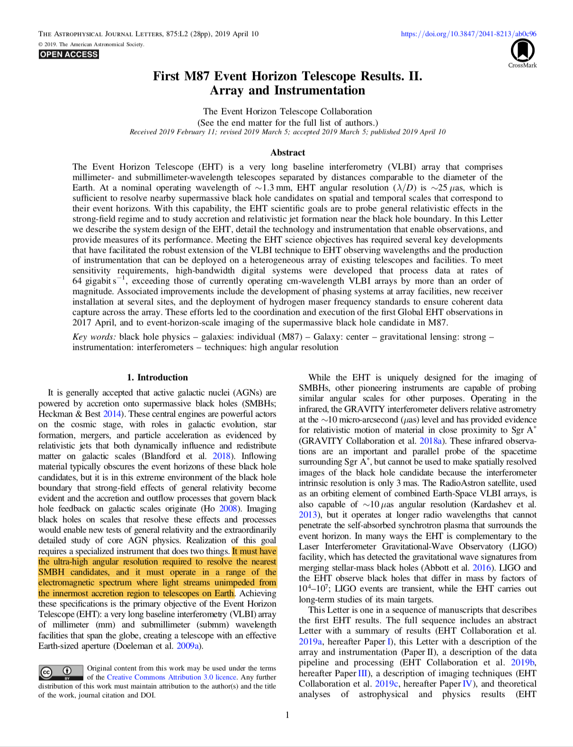

Slide 3
A Monster in the Milky Way…
Movie spans
~20 years
This movie tells us:
Mass of central point-source = ~4 million solar masses
Closest approach of S2 is only 17 light hours
Orbital period = ~16 years (a bit longer than that of Jupiter)
—> Black Hole?

Slide 4
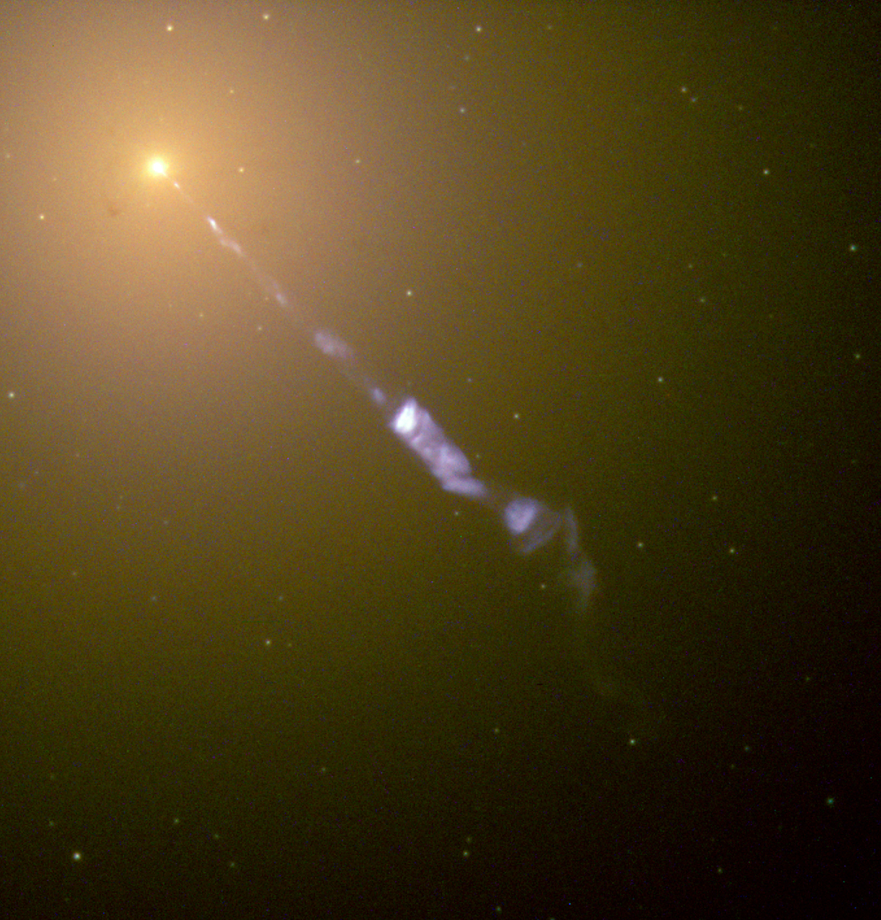
A Monster in M87…
Quick facts:
53.5 million light years away
Estimated mass = 6.5 billion solar masses
One to the most massive galaxies in the local universe

Slide 5
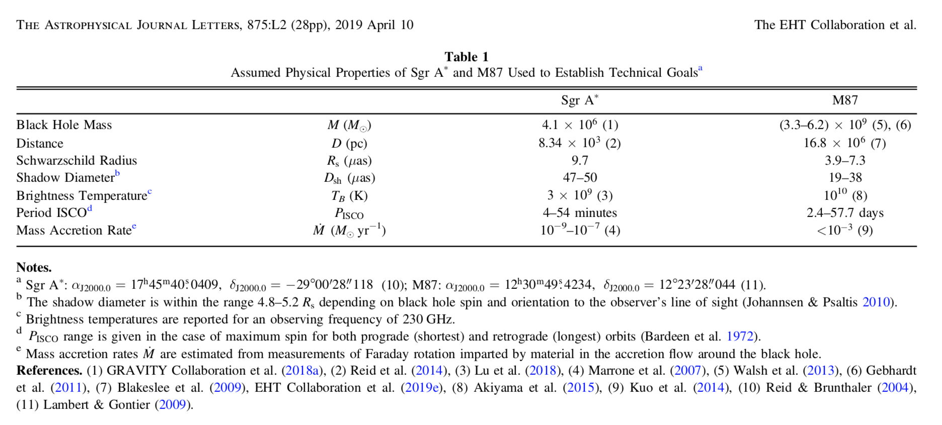
From “Paper II”
Uncertainty in M87 mass
Despite vast differences in mass and distance, angular size of event horizons for both black holes are similar!
Sgr A*
M87
Light crossing times GM/c^3:
20 s
8.5 hr

Slide 6
How large a telescope?
Observing at lambda = 1.3 mm, say our aperture is the diameter of the Earth (12,742 km), then:
r = lambda / D = ~10^(-10) radians = 21 uas…
Oh no… that’s twice the Schwarzschild radius… how do we expect to see anything?

Slide 7
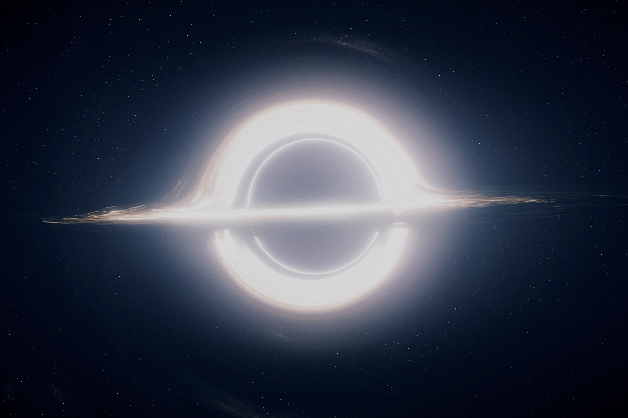
What do we expect to see?
—> No relativistic beaming / blue shifting
—> A more accurate picture?

Slide 8
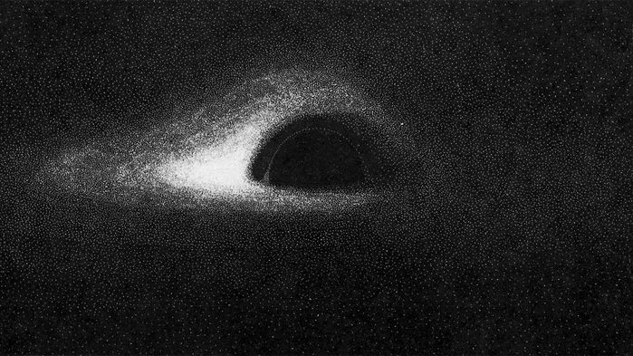
Jean-Pierre Luminet, 1979
Length scales to consider:
Event horizon: 1 Rs
Photon Sphere: 1.5*Rs
Innermost stable circular orbit (ISCO): 3*Rs
Photon capture radius: 1/2 sqrt(27)*Rs (~2.6 Rs)

Slide 9
Did EHT answer any outstanding questions?
Mass of M87 - two ways to calculate
Modeling of surface brightness and stellar velocity dispersion yields 6.2(+1.1/-0.6) billion solar masses
Modeling kinematic structure of gas disk yields 3.5(+0.9/-0.3) billion solar masses
—> Takeaway: Astronomy is hard
But EHT measured a shadow consistent with a black hole mass of 6.5(+/-0.7) billion solar masses - looks like option 1 was correct!

Slide 10
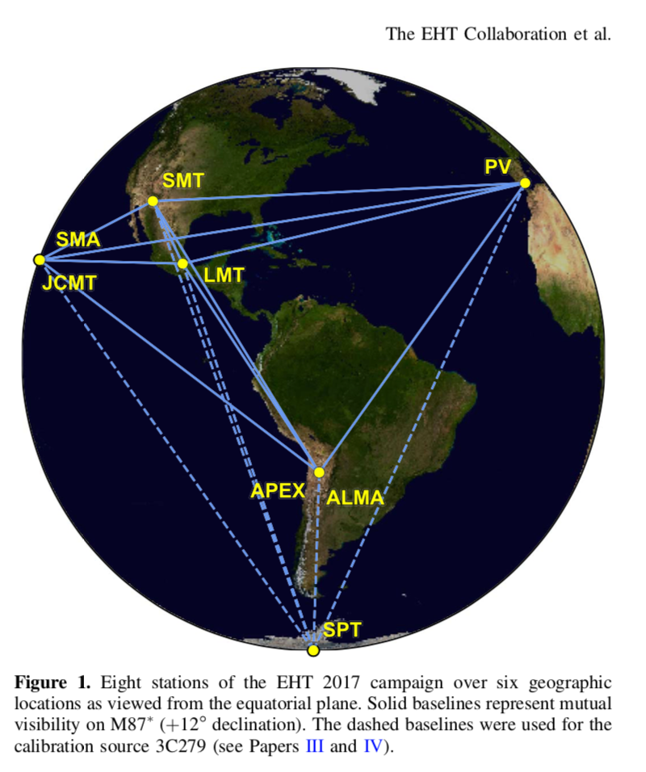
Details of EHT
Observe at 1.3 mm wavelengths (230 GHz)
Coherent integration time = 10 seconds
Limited by atmospheric conditions
GPS synchronizes to within tens of ns
Do you need RF
electronics that fast? (nope!)

Slide 11
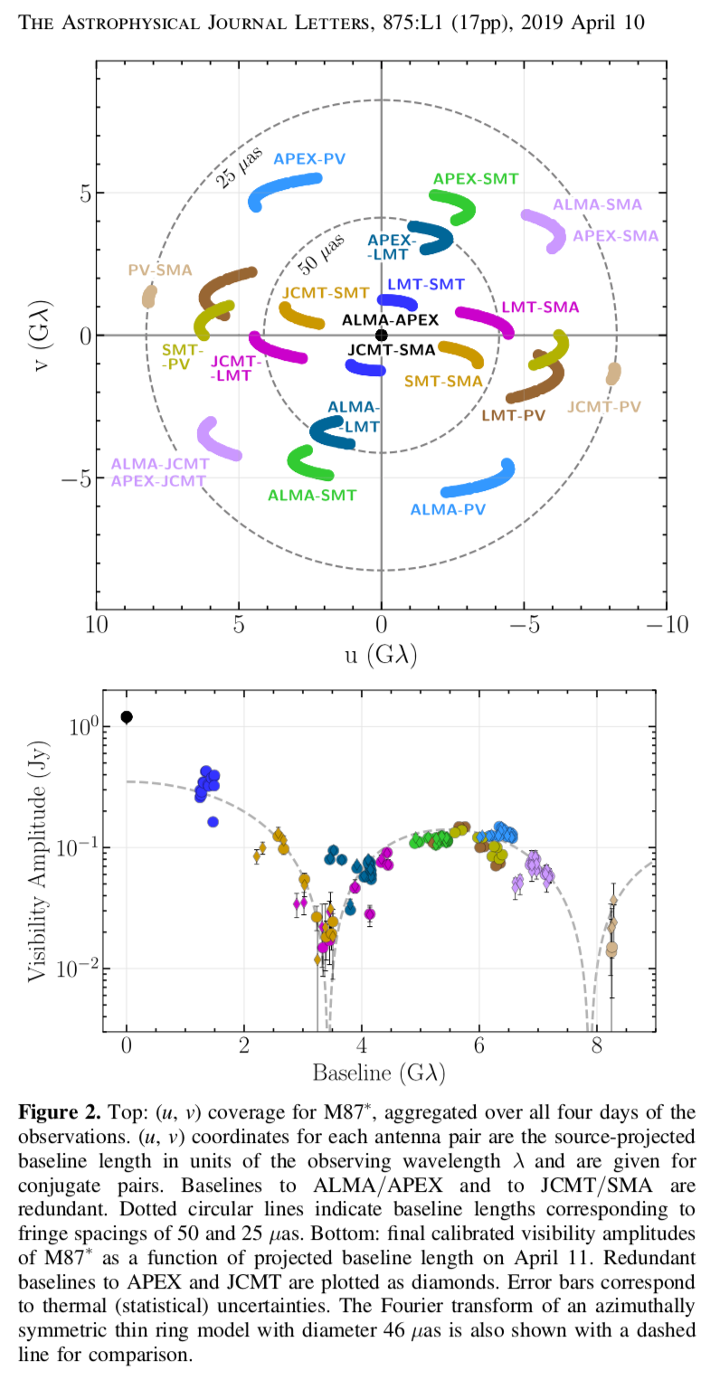

Slide 12
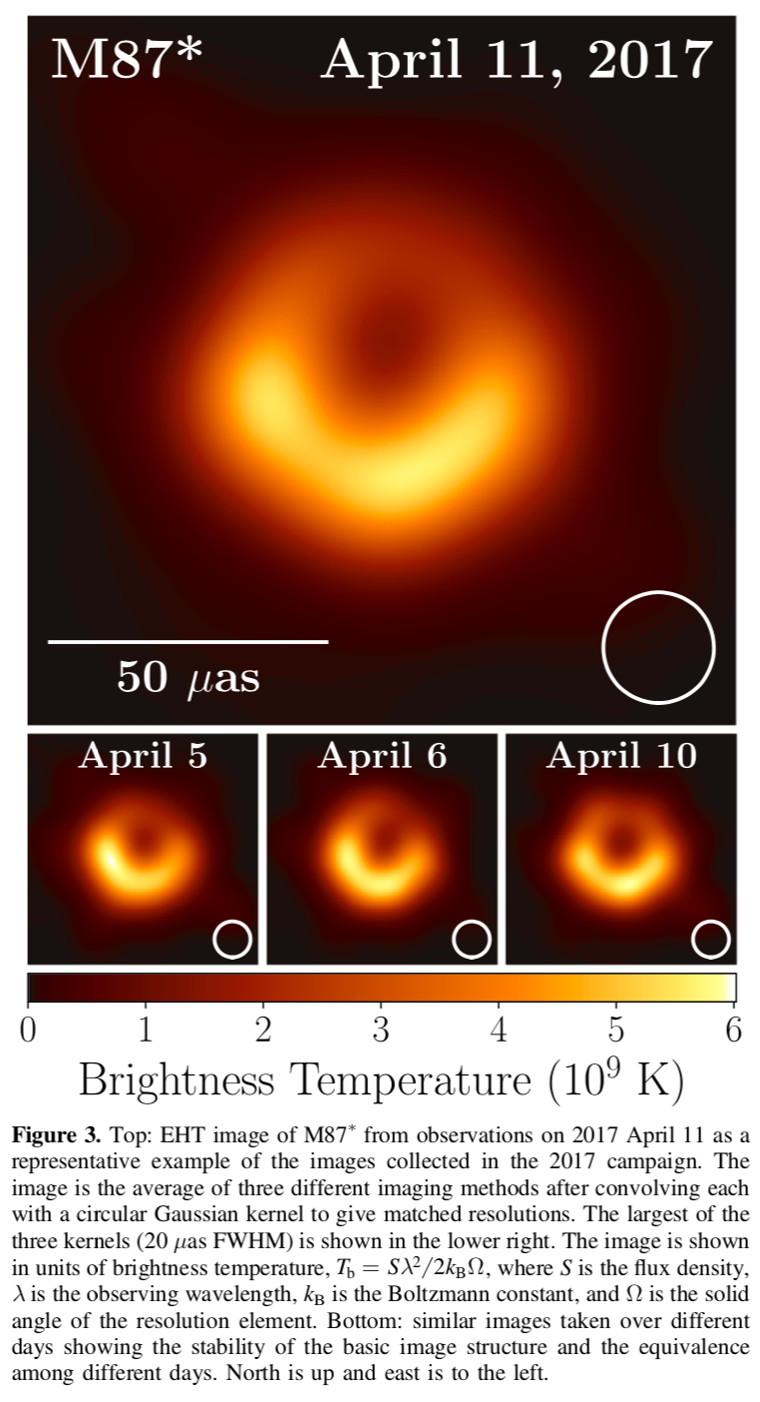
Event horizon
Shadow
Resolution

Slide 13
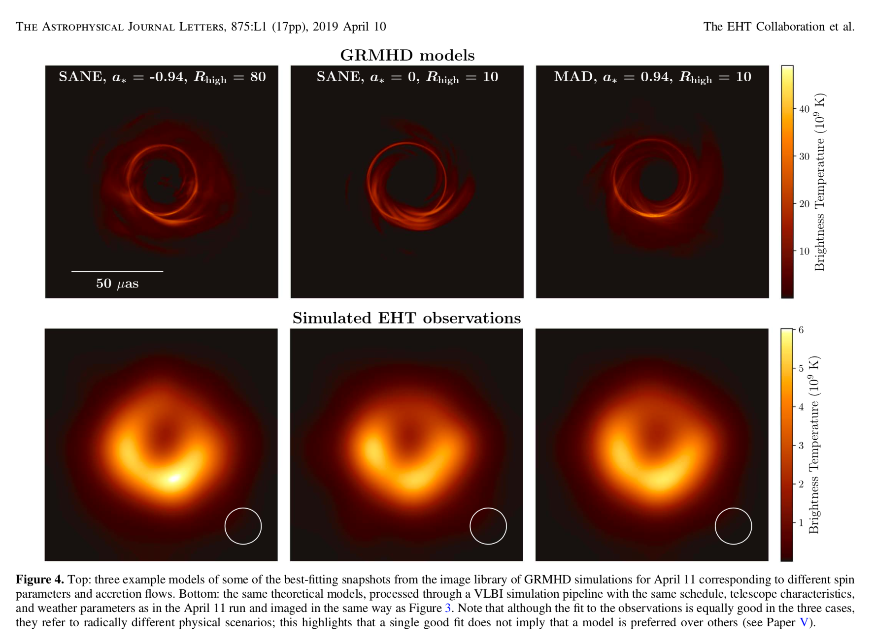

Slide 14
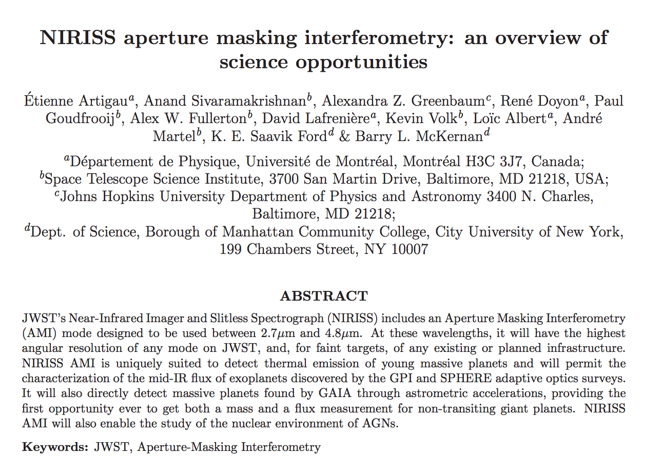
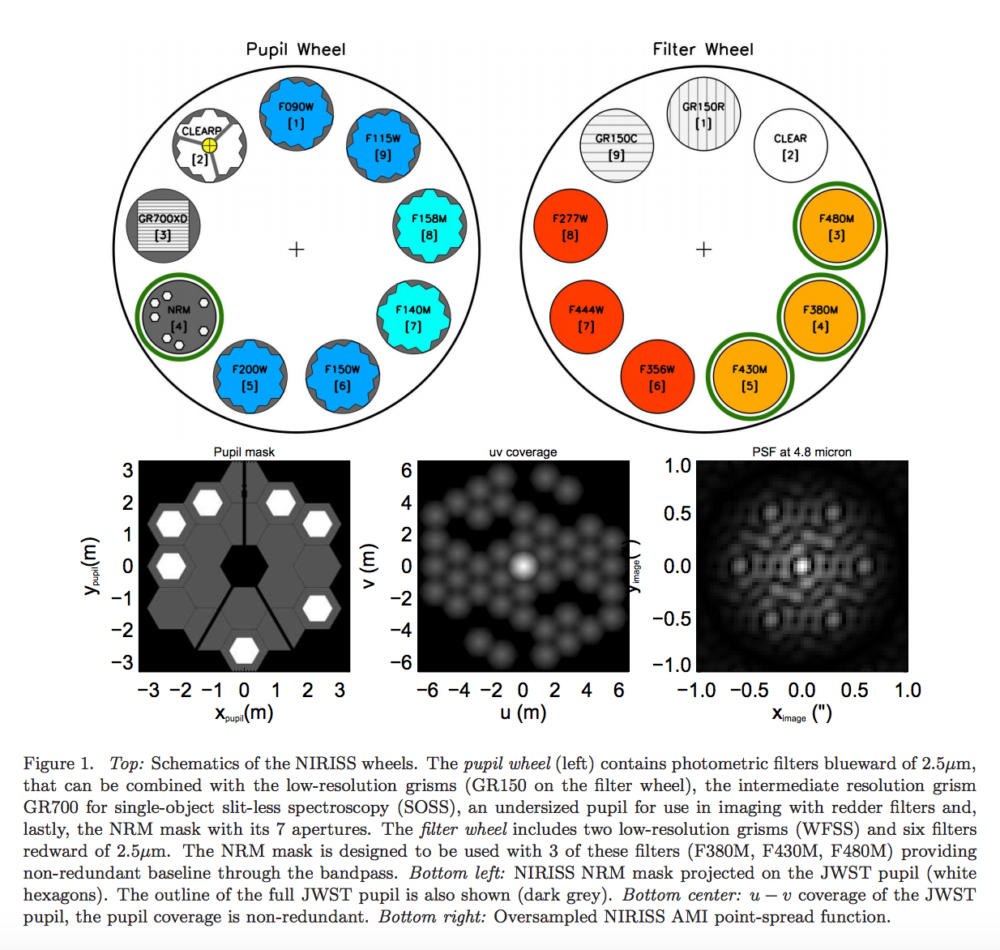
Aside: Aperture masking interferometry

