Slide 1
Physics 471 – Introduction to Modern Atomic Physics
The Bose-Hubbard Model
Lecturer: Lev Khaykovich

Slide 2
Quantum phase transitions
S. Sachdev and B. Keimer, Physics Today 64 (2), 29 (2011)
Quantum phase transitions occur even at zero temperature.
They are a result of competition between different energies, and are initiated by quantum fluctuations.
Superfluid to Mott insulator transition is a (text book) example of the quantum phase transition. The two competing energies are kinetic and (on-site) interaction energies.
Bose-Hubbard model describes this phase transition and it is realizable with ultracold atoms.

Slide 3
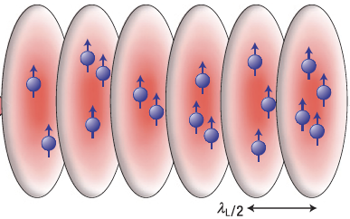
Optical lattices and Bloch bands
Optical potential: R. Grimm, M. Weidemüller and Y. B. Ovchinnikov, Adv. At., Mol., Opt. Phys. 42, 95 (2000)
Periodic potential is generated by overlapping two counterpropagating laser beams.
$$V\left(r,z\right)=−V_{0}e^{−\frac{2r^{2}}{w^{2}\left(z\right)}}\sin{{\left(kz\right)}^{2}}$$
For a gaussian profile:
$$k=2π/λ$$

Slide 4
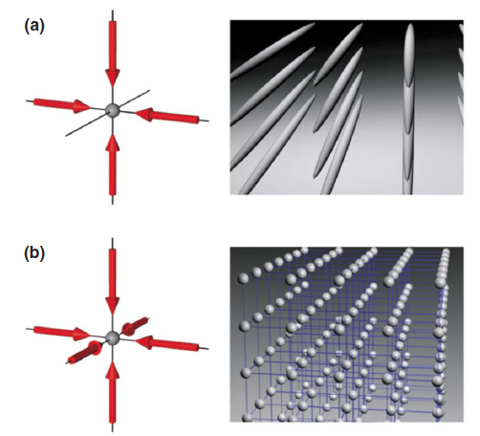
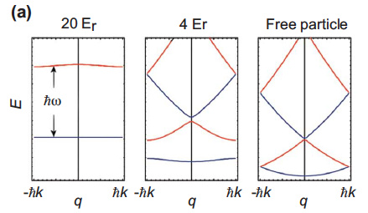
Optical lattices and Bloch bands
Optical potential: R. Grimm, M. Weidemüller and Y. B. Ovchinnikov, Adv. At., Mol., Opt. Phys. 42, 95 (2000)
Periodic potential is generated by overlapping two counterpropagating laser beams.
$$V\left(r,z\right)=−V_{0}e^{−\frac{2r^{2}}{w^{2}\left(z\right)}}\sin{{\left(kz\right)}^{2}}$$
For a gaussian profile:
$$k=2π/λ$$
2D potential is created by overlapping two optical standing waves:
3D potential is created by overlapping three optical standing waves:
Bloch bands for different potneial depths:
$$E_{r}=\frac{{\left(ℏk\right)}^{2}}{2m}$$
I. Bloch, J. Dalibard, W. Zwerger, Rev. of Mod. Phys. 80, 885 (2008)

Slide 5
Bose Hubbard model
Hamiltonian:
$$\hat{H}=−\sum_{ij}{t_{ij}}{\hat{b}}_{i}^{†}{\hat{b}}_{j}+\frac{U}{2}\sum_{i}{{\hat{n}}_{i}\left({\hat{n}}_{i}−1\right)−μ}\sum_{i}{{\hat{n}}_{i}}$$
( $i,j$ are nearest neighbour sites)
In the limit of tight-binding approximation ($t_{ij}=0$): the Hamoltonian is diagonal in occupation number basis $|n⟩$.
Eigenvalues: $E_{n}^{0}=\frac{U}{2}n\left(n−1\right)−μn$
Macroscopic degeneracy in the tight-binding limit:
requiring
$$E_{n}^{0}=E_{n+1}^{0}$$
$$μ_{n}^{0}=nU$$
The nature of ground state is, thus, defined by the chemical potential $μ$ :
If $μ∈ ](n−1)U,nU[$ , the ground state is nondegenerate.
If $μ=nU$, the ground state is $2^{N_{s}}$ degenerate ($N_{s}$ is the number of sites) – having $n$ or $n−1$ particles are equally probable.

Slide 6
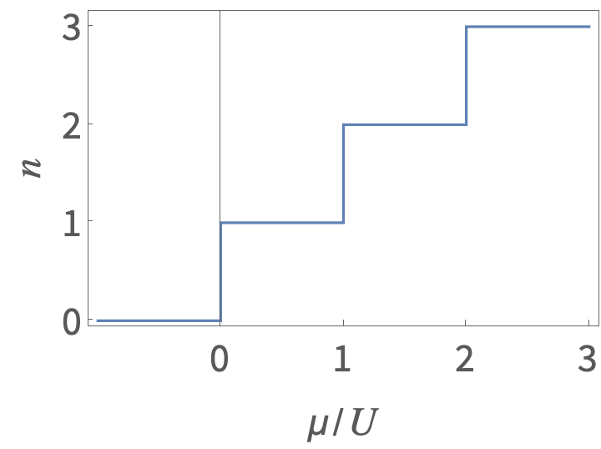
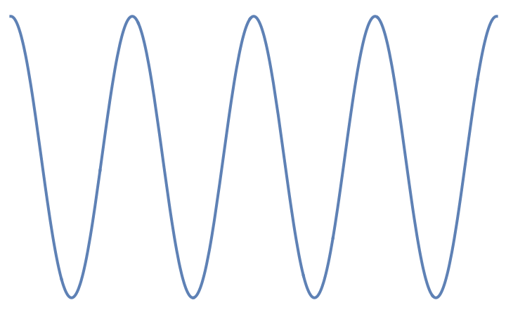
Lifting the macroscopic degeneracy
Staircase form of the ground state in the tight-binding limit:
The first excited state is separated from the ground state by a gap:
$$∆_{g}^{0}=E_{n+1}^{0}+E_{n−1}^{0}−2E_{n}^{0}=U$$
$$n−1$$
$$n+1$$
vacuum
When $t_{ij}>0$ (small perturbation):
A$t μ=nU$ points the macroscopic degeneracy is removed.
The obtained state is a superfluid (a superposition of all possible degenerate states with reduced phase fluctuations).
Each plateau shows vanishing compressibility:
$$κ={\left(\frac{∂^{2}E}{∂n^{2}}\right)}^{−1}=\frac{∂n}{∂μ}≈0$$

Slide 7
Mean-field theory of the Hubbard model
The idea of mean-field approach:
$$b_{i}^{†}b_{j}⟶C+\left\langle b_{i}^{†}\right\rangle b_{j}+b_{i}^{†}\left\langle b_{j}\right\rangle +…$$
(expressing the fluctuation field $δb_{i}^{†}=b_{i}^{†}−\left\langle b_{i}^{†}\right\rangle$ ($δb_{j}=b_{j}−\left\langle b_{j}\right\rangle$) and neglecting these fluctuations $δb_{i}^{†}δb_{j}≈0$).
Then, the effective one-site Hamiltonian is:
$${\hat{H}}_{eff}=−λ_{i}\left(b^{†}+b\right)+\frac{U}{2}\hat{n}\left(\hat{n}−1\right)−μ\hat{n}$$
where
$$λ_{i}=\sum_{j}{t_{ij}\left\langle b_{j}\right\rangle }$$
For uniform lattice with connectivity $z$ and nearest-neighbour hopping:
$$λ=zt\left\langle b\right\rangle$$
where $\left\langle b\right\rangle$ is the order paramter associated with Bose condensate.
Solution:
Self-consistent iterative diagonalization while satisfying equation for $λ$
Perturbation theory analysis

Slide 8
Mean-field theory: perturbative analysis
$$|\left.ψ\right\rangle =\left.|n\right\rangle −λ\left[\frac{\sqrt{n}}{U\left(n−1\right)−μ}\left.|n−1\right\rangle +\frac{\sqrt{n+1}}{μ−Un}\left.|n+1\right\rangle \right]$$
First order correction to the eigenstates:
leads to the second order correction to the energies:
$$\left\langle ψ | b | ψ\right\rangle =−λ\left[\frac{n}{U\left(n−1\right)−μ}+\frac{n+1}{μ−Un}\right]$$
The self-consistency condition:
$$λ=−ztλ\left[\frac{n}{U\left(n−1\right)−μ}+\frac{n+1}{μ−Un}\right]$$
$$z\frac{t}{U}=\frac{\left(n−\frac{μ}{U}\right)\left(\frac{μ}{U}−n+1\right)}{1+\frac{μ}{U}}$$
leads to the critical boundary condition:

Slide 9
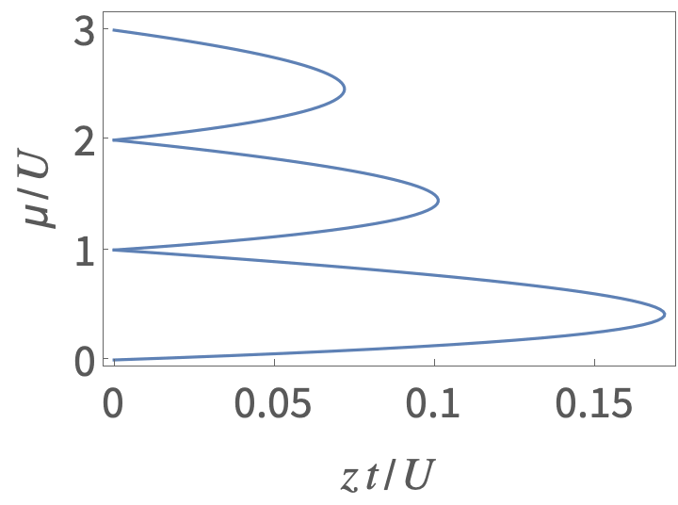
Superfluid to Mott insulator transition
$$z\frac{t}{U}=\frac{\left(n−\frac{μ}{U}\right)\left(\frac{μ}{U}−n+1\right)}{1+\frac{μ}{U}}$$
Critical boundary condition (CBC):
Phase diagram
SF
MI
$$n=3$$
Mott gap
MI
$$n=2$$
$$Δ_{g}\left(n\right)=μ_{+}\left(n\right)−μ_{−}(n)$$
MI
From the solution of CBC :
$$n=1$$
$$Δ_{g}\left(n\right)=U\sqrt{\left[{\left(\frac{zt}{U}\right)}^{2}−2\left(2n+1\right)\frac{zt}{U}+1\right]}$$
$$\frac{zt}{U}→0$$
$$Δ_{g}\left(n\right)≈U$$
$${\left(\frac{U}{zt}\right)}_{c}≈5.8$$

Slide 10
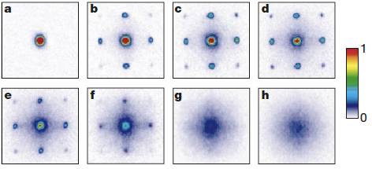
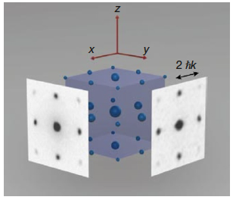
Experimental demonstration
M. Greiner, O. Mandel, T. Esslinger, T. W. Hänsch and I. Bloch, Nature 415, 39 (2002)
1) BEC of Rb is loaded into a 3D optical lattice potential (150,000 lattice sites are occupied) with 2.5 atoms/site in the center.
2) At $t=0$ BEC is released for a TOF.
3D interference pattern for different potneital depths:
3D interference pattern from
a periodic array of phase coherent sources
located at each site of optical lattice.
$a) No lattice$
e$) 13 E_{r}$
b$) 3 E_{r}$
f$) 14 E_{r}$
c$) 7 E_{r}$
g$) 16 E_{r}$
d$) 10 E_{r}$
h$) 20 E_{r}$

Slide 11
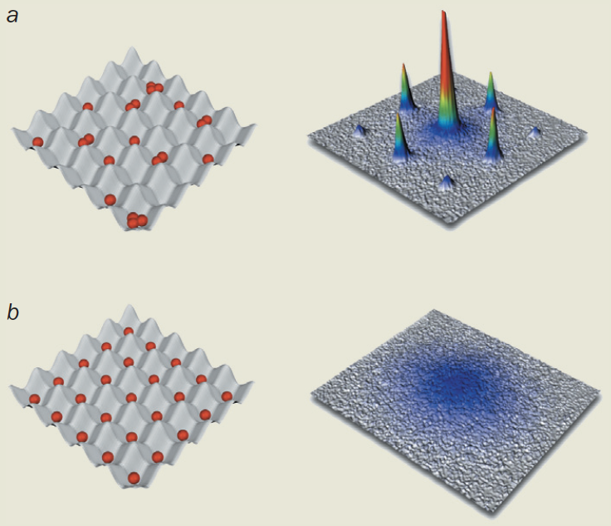
Experimental demonstration
I. Bloch, Phys. World 17, 25 (2004)
superfluid
Mott insulator

Slide 12
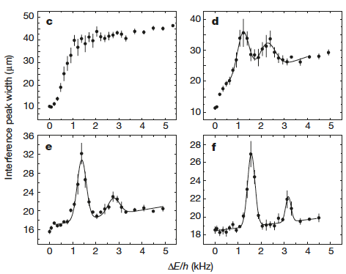
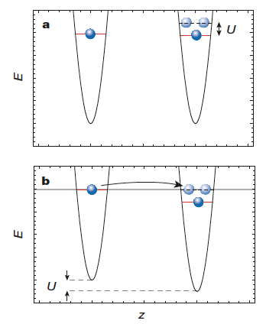
Excitation spectrum: observation of the Mott gap
M. Greiner, O. Mandel, T. Esslinger, T. W. Hänsch and I. Bloch, Nature 415, 39 (2002)
Excitation gap with 1 atom/site
Interferometric peak at different potential gradients. Mott insulator phase is largerly protected from excitation and is characterized by a sharp peak.
Tunneling is allowed when potential gradient matches the on-site interaction energy.

Slide 13
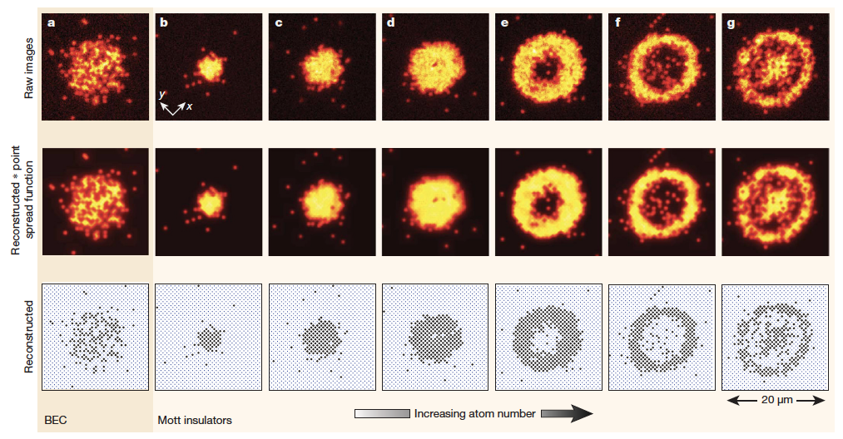
Experimental demonstration
J. F. Sherson, C. Weitenberg, M. Endres, M. Cheneau, I. Bloch and S. Kuhr, Nature 467, 68 (2010)
Single-site resolution imaging of Mott Insulator phase: “wedding-cake” type structure.
Only odd number
of atoms survive.

Slide 14
Bose-Hubbard model related phenomena
Coherence, critical momentum (dynamics), number statistics, particle-hole admixture.
Low-dimensional systems: superfluid to Mott insulator transition in 1D and 2D systems
Fermi-Hubbard model
Magnetic phases of bosonic and fermionic mixtures on lattices
etc…

